Slide 1

Q4 2023 Statistics Book
Published
www.registry-trust.org.uk/

Slide 2

INTRODUCTION
Registry Trust was established in 1985 to maintain the only official statutory Register of Judgments, Orders, and Fines for England & Wales on behalf of the Ministry of Justice, and maintains similar Registers for Scotland, Northern Ireland, Republic of Ireland, Isle of Man, and Jersey by agreement with the relevant authorities.
Our ‘live’ data on monetary judgments (including CCJs) supports millions of lending and credit decisions in the British Isles & Ireland every year and can be used to identify trends, including the current economic and social realities for those in the most vulnerable situations. It even creates usable credit metrics through the absence of a judgment record.
As a not-for-profit company which doesn't cost the government or tax-payer any money, we provide a trusted and impartial source of credit information and place no interpretation on the content of the Register; we simply ensure that the records published are as accurate and up to date as possible. Our mission is to use and share this public data for public good to:
Methodologically, the data in this report reflects the records received during the previous fifteen months and the analysis is done each quarter as part of this publication. Seasonal variations affecting the workload of the courts and differing economic conditions may have an impact on the statistics and the variations between periods. Where there are factors known to have influenced the volume or value of the statistics in this report these are commented on.
NOTE: High Court and 'Scotland Ordinary Causes’ jurisdictions were separated from the analysis because they inflate key metrics with their unusually high judgment values and provide an unrealistic view of the average business/individual.
www.registry-trust.org.uk/

Slide 3
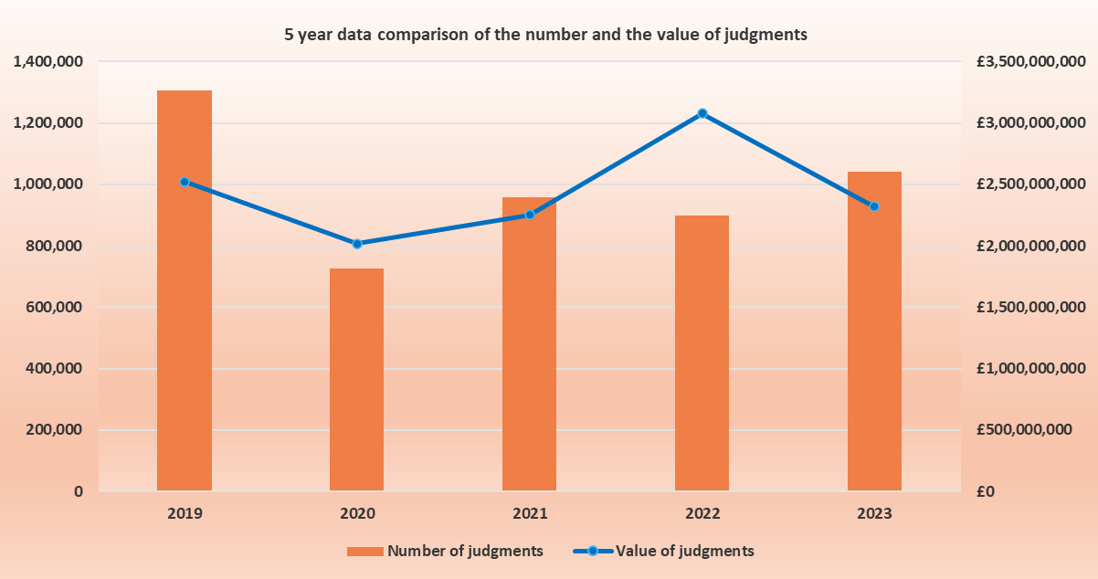
2023 UK ANNUAL STATISTICS
TOTAL NUMBER OF JUDGMENTS:
1,042,556
TOTAL VALUE OF JUDGMENTS: £2,317,083,600
TOTAL NUMBER OF
‘SATISFIED’
JUDGMENTS:
179,349
Including High court judgments
www.registry-trust.org.uk/

Slide 4
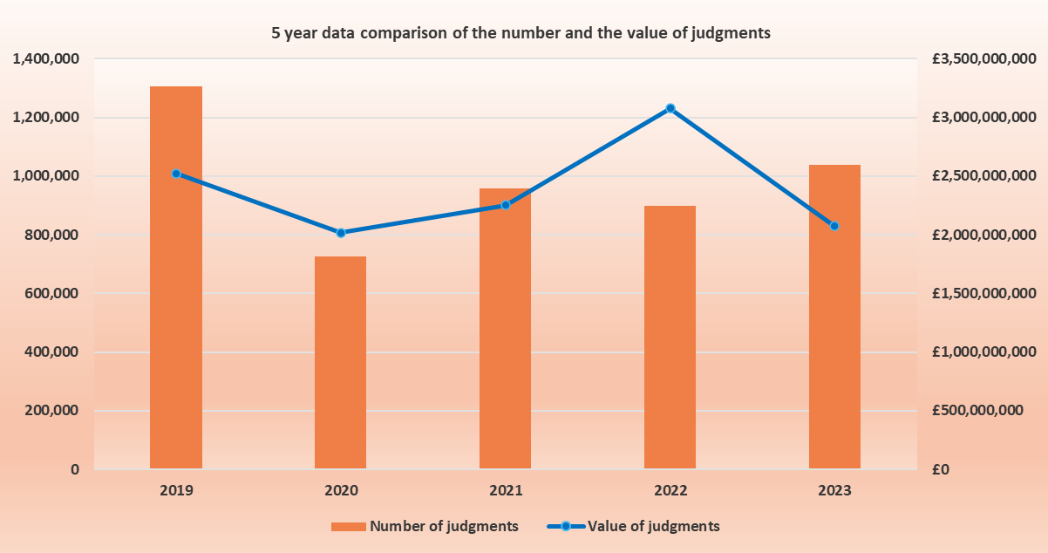
2023 UK ANNUAL STATISTICS
TOTAL NUMBER OF JUDGMENTS:
1,039,585
TOTAL VALUE OF JUDGMENTS: £2,072,895,605
TOTAL NUMBER OF
‘SATISFIED’
JUDGMENTS:
179,234
Dose not include High court judgments for 2023
www.registry-trust.org.uk/

Slide 5
QUARTERLY ROUND UP
REGIONAL SHARE
ENGLAND AND WALES | 97.58%
SCOTLAND | 1.39%
NORTHERN IRELAND | 0.62%
REPUBLIC OF IRELAND | 0.27%
JERSEY | 0.10%
ISLE OF MAN | 0.04%
243,448 NEW JUDGMENTS
WERE PROCESSED THIS
QUARTER WITH A TOTAL
VALUE OF £502,387,690 EXCLUDING
HIGH COURT AND SCOTLAND ORDINARY
CAUSES. 43,079 SATISFACTIONS WERE
PROCESSED QUARTERLY
During the period of 1st October 2023 to 31st
December 2023, 97.58% of all judgments came
from courts in England and Wales.
Compared to the same period last year, the
number of judgments across all jurisdictions
saw a 6.13% decrease moving from 259,343 to
243,448.
The average value of judgments across all
jurisdictions this quarter was £2,063.
This represents a decrease in the
average value of 2.31%
as compared to Q3 2023.
www.registry-trust.org.uk/

Slide 6
ENGLAND
& WALES
www.registry-trust.org.uk/

Slide 7
SMALL DECREASE IN COUNTY COURT JUDGMENTS
This quarter of Q4 2023 has seen a slight decrease of 6.14% in the number of County Court Judgments, from 253,093 in Q3 2023 to 237,558 in Q4 2023.
In this quarter there has been a decrease in the number of Tribunal awards in Q4 2023 of 1.64% as compared to the previous quarter, from 61 in Q3 2023 to 60 in Q4 2023.
The number of administration orders has increased by 61.54% from 13 in Q3 2023 to 21 in Q4 2023.
*County Court Judgments are plotted on the right hand axis.
www.registry-trust.org.uk/

Slide 8
DECREASE IN NUMBER OF ALL JUDGMENT
This quarter has seen a slight decrease in consumer judgments of 5.78% from the last quarter, from 224,152 in Q3 2023 to 211,202 in Q4 2023.
Commercial judgments have also seen a decrease of 8.93%, from 28,941 in Q3 2023 to 26,356 in Q4 2023.
The number of corporate judgments decreased this quarter, from 22,328 in Q3 2023 to 21,130 in Q4 2023, a drop of 5.37%.
Continuing the trend non-corporate judgments have seen a 20.97% decrease from 6,613 in Q3 2023 to 5226 in Q4 2023.
*Consumer judgments are plotted on the right hand axis.
www.registry-trust.org.uk/

Slide 9
DECREASE IN TOTAL VALUE OF ALL JUDGMENTS
The total value of consumer judgments has seen a decrease of 10.99% this quarter, from £391 million in Q3 2023 to £348 million in Q4 2023.
Non-corporate judgments also experienced a decrease of 20.64% in total value from £22.6 million in Q3 2023 to £17.99 million in Q4 2023.
Corporate judgments saw a decrease of 2.29% in total value, from £102 million in Q3 2023 to £100 million in Q4 2023.
The trend continues with commercial judgments experiencing a decrease in total value, from £125 million in Q3 2023 to £118 million in Q4 2023, a drop of 5.61%.
*Consumer judgments are plotted on the right hand axis.
www.registry-trust.org.uk/

Slide 10
INCREASE IN AVERAGE VALUE APART FROM CONSUMER JUDGMENTS
The average value of commercial judgments increased by 3.64% from £4,321 in Q3 2023 to £4,478 in Q4 2023.
Corporate judgments have seen an increase of 3.25% in the average value from £4,585 in Q3 2023 to £4,734 in Q4 2023.
Non-corporate judgments also saw a slight increase of 0.42% in average value, from £3,429 in Q3 2023 to £3,443 in Q4 2023.
However, consumer judgments decreased slightly by 5.54% in average value, from £1,744 in Q3 2023 to £1,648 in Q4 2023.
www.registry-trust.org.uk/

Slide 11
A CLOSER INSIGHT INTO THE JUDGMENT VALUES OF E&W
When analysing the breakdown of commercial judgments there has been no significant changes with only a 2.39% increase of judgments valued greater than £3,000.
The breakdown of consumer judgments also has seen no significant changes with only a 5.11% increase of judgments valued between £100-500.
www.registry-trust.org.uk/

Slide 12
SCOTLAND
www.registry-trust.org.uk/

Slide 13
OVERALL, THE NUMBER OF ALL DECREES DECREASED
Scotland small claims consumer cases have seen a slight decrease of 6.82%, from to 2,960 cases in Q3 2023 to 2,758 cases in Q4 2023.
Scotland small claims commercial cases have decreased by 16% from 738 claims in Q3 2023 to 620 in Q4 2023.
*Scotland Small Claims Consumer judgments plotted solely on the right hand axis.
www.registry-trust.org.uk/

Slide 14
DECLINE IN THE NUMBER OF ALL DECREES
The number of commercial decrees has seen a decline of 16%, from 738 in Q3 2023 to 620 in Q4 2023.
The number of corporate decrees also decreased by 16.75% from 627 in Q3 2023 to 522 in Q4 2023.
Non-corporate decrees have decreased by 11.71%, from 111 in Q3 2023 to 98 in Q4 2023.
The number of consumer decrees has seen a slight decrease of 6.82%, from 2,960 in Q3 2023 to 2,758 in Q4 2023.
*Consumer decrees plotted solely on the right hand axis.
www.registry-trust.org.uk/

Slide 15
DECREASE IN TOTAL VALUE FOR ALL DECREE
Commercial decrees saw a decrease in total value of 17.27%, from £1.18 million in Q3 2023 to £976,443in Q4 2023.
Corporate cases also experienced a decrease in total value of 13.37%, from £ 1,008,117 in Q3 2023 to £790,297 in Q4 2023.
Non-corporate cases decreased in total value by 30.55% from £268,021 Q3 2023 to £186,146 Q4 2023.
Consumer cases have seen a decrease in total value of 6.36%, from £ 5.7 million Q3 2023 to £5.37 million in Q4 2023.
*Consumer decrees plotted solely on the left hand axis.
www.registry-trust.org.uk/

Slide 16
DECREASE IN THE AVERAGE VALUE FOR NON-CORPORATE & COMMERCIAL CASES
The non-corporate average value decreased by 21.33%, from £2,415 Q3 2023 to £1,899 in Q4 2023.
Commercial decrees also experienced a decrease in average value from £1,599 in Q3 2023 to £1,575 in Q4 2023, a slight drop of 1.53%.
However, the average value of corporate decrees saw a small increase of 4.05%, from £1,455 in Q3 2023 to £1,514 in Q4 2023.
Consumer decrees have also seen a small increase in average value of 0.49% , from £1,936 in Q3 2023 to £1,945 in Q4 2023.
www.registry-trust.org.uk/

Slide 17
A CLOSER INSIGHT INTO THE DECREES VALUES FOR SCOTLAND
The commercial breakdown shows that case valued between £100-500 has seen a decrease of 12.2%. The breakdown also shows that cases valued between £500-1,000 saw an increase of 12.6%.
The consumer breakdown shows a 2.3% increase from Q3 2023 to Q4 2023 of the values between of £2,000-3,000.
www.registry-trust.org.uk/

Slide 18
NORTHERN IRELAND
www.registry-trust.org.uk/

Slide 19
DECLINE IN THE NUMBER OF ALL JUDGMENTS
Non-corporate judgments saw a decrease of 29.03%, from 31 in Q3 2023 to 22 in Q4 2023.
Corporate judgments also decreased by 18.50%, from 427 in Q3 2023 to 348 in Q4 2023.
Commercial judgments experienced a decrease of 19.21%, from 458 in Q3 2023 to 370 in Q4 2023.
Continuing this trend, consumer judgments also decreased by 9.05%, from 1,249 in Q3 2023 to 1,136 in Q4 2023.
.
*Consumer Judgments plotted on the right-hand axis.
www.registry-trust.org.uk/

Slide 20
DECREASE IN THE TOTAL VALUE OF ALL JUDGMENTS
Non-corporate cases saw a decrease of 56.56% in total value, from £122k in Q3 2023 to £53K in Q4 2023.
The total value of corporate judgments also decreased by 13.76% from £ 842,738 in Q3 2023 to £726,751 in Q4 2023.
Commercial judgments also experienced a decrease of 19.17%, from £964,711 in Q3 2023 to £779,740 in Q4 2023.
Continuing this trend, the total value of consumer judgments decreased by 30.63%, from £2.98 million Q3 2023 to £2.07 million in Q4 2023.
*Non-corporate judgments solely plotted on the right hand axis.
www.registry-trust.org.uk/

Slide 21
DECREASE IN THE AVERAGE VALUE OF NON-CORPORATE & CONSUMER JUDGMENTS
Non- corporate judgments experienced a decrease of 38.78% in average value from £3,935 in Q3 2023 to £2,409 in Q4 2023.
Consumer judgments also saw a decrease of 23.73% in average value, from £2,390 Q3 2023 to £1,823 Q4 2023.
However, the average value of corporate judgments experienced a 5.81% increase, from £1,974 in Q3 2023 to £2,088 in Q4 2023.
Commercial judgments also saw a slight increase of 0.05% in average value from £2,106 in Q3 2023 to £2,107 in Q4 2023.
www.registry-trust.org.uk/

Slide 22
A CLOSER LOOK INTO THE JUDGMENT VALUES OF NORTHERN IRELAND
Analysing the breakdown of commercial judgments shows a 16.46% decrease of the values between of £100-500. The values between £500-1,000 saw an increase of 14.73%
Consumer judgments have remained consistent from Q3 2023 to Q4 2023.
www.registry-trust.org.uk/

Slide 23
REPUBLIC OF IRELAND
www.registry-trust.org.uk/

Slide 24
INCREASE IN THE NUMBER OF ALL JUDGMENTS APART FROM NON- CORPORATE
Consumer judgments have seen an increase of 16.43%, from 359 in Q3 2023 to 418 in Q4 2023.
Corporate judgments have also seen an increase of 37.42%, from 155 in Q3 2023 to 213 in Q4 2023.
The trend continues with commercial judgments increasing by 31.02%, from 187 in Q3 2023 to 245 in Q4 2023.
However non- corporate judgments have remained the same, from 32 in Q3 2023 to 32 in Q4 2023.
www.registry-trust.org.uk/

Slide 25
INCREASE IN TOTAL VALUE OF ALL JUDGMENTS APART FROM NON- CORPORATE
Corporate judgments have seen an increase of 94.09% in total value, from €3 million in Q3 2023 to €5.8 million in Q4 2023.
The total value of commercial judgments went from €3.4 million in Q3 2023 to €6.1 million in Q4 2023, a 79.76% increase.
The total value of consumer judgments has seen an increase of 22.16%, from €16 million in Q3 2023 to €19.96 million in Q4 2023.
However, the total value of non-corporate judgments has decreased by 27.85%, from €400.9k in Q3 2023 to €289.3k in Q4 2023.
*Consumer judgments solely plotted on the right hand axis.
*There is an outlier non-corporate judgment for £1,163,807 which has increased total value.
www.registry-trust.org.uk/

Slide 26
INCREASE IN THE AVERAGE VALUE OF JUDGMENTS APART FROM NON- CORPORATE
The average value of corporate judgments increased, from €19k in Q3 2023 to €27.4K in Q4 2023, a rise of 41.24%.
The average value of commercial judgments also saw an increase of 37.20%, from €18k in Q3 2023 to €25k in Q4 2023.
The trend continues with the average value of consumer judgments experiencing a small increase of 4.92%, from €45.5k in Q3 2023 to €47.7k in Q4 2023.
However, the average value of non-corporate judgments has seen a decrease of 27.85%, from €12.6K in Q3 2023 to €9K in Q4 2023.
www.registry-trust.org.uk/

Slide 27
A CLOSER LOOK INTO JUDGMENT VALUES IN THE REPUBLIC OF IRELAND
Commercial judgments have seen a 6.76% decrease in the proportion of judgments valued between £1,500-2,000. The proportion of judgments valued greater than £3,000 increased by 5.47%, from Q3 2023 to Q4 2023.
Consumer judgments have remained consistent from Q3 2023 to Q4 2023.
www.registry-trust.org.uk/

Slide 28
JERSEY
www.registry-trust.org.uk/

Slide 29
INCREASE IN THE NUMBER OF JUDGMENTS,
EXCEPT FOR NON-CORPORATE & CONSUMER JUDGMENTS
Corporate judgments increased from 29 in Q3 2023 to 40 in Q4 2023, a rise of 37.93%.
Commercial judgments also experienced an increase of 23.08%, from 39 in Q3 2023 to 48 in Q4 2023.
However, non-corporate judgments have seen a decrease of 20%, from 10 in Q3 2023 to 8 in Q4 2023.
The number of consumer judgments also saw a decrease of 25.10%, from 251 in Q3 2023 to 188 in Q4 2023.
*Consumer Judgments plotted on the right hand axis.
www.registry-trust.org.uk/

Slide 30
INCREASE IN TOTAL VALUE OF ALL JUDGMENTS EXCEPT FOR CONSUMER
The total value of non-corporate judgments saw an increase, from £17k in Q3 2023 to £40.3k in Q4 2023, a rise of 134.46%.
The total value of corporate judgments also increased by 13.10%, from £418K in Q3 2023 to £472.9k in Q4 2023.
Following this trend, the total value of commercial judgments saw an increase of 17.89%, from £435.4k in Q3 2023 to £513k in Q4 2023.
However, the total value of consumer judgments decreased by 51.25%, from £689.7k in Q3 2023 to £336k in Q4 2023.
*Consumer Judgments plotted on the right hand axis.
www.registry-trust.org.uk/

Slide 31
DECREASE IN AVERAGE VALUE OF ALL JUDGMENTS EXCEPT NON-CORPORATE
The average value consumer judgments decreased by 34.91%, from £2,748 in Q3 2023 to £1,789 in Q4 2023.
The average value of corporate judgments also decreased by 18%, from £14,419 in Q3 2023 to £11,823 in Q4 2023.
Following the trend commercial judgments decreased by 4.21%, from £11,162 in Q3 2023 to £10,693 in Q4 2023.
However, non-corporate judgments saw a considerable increase of 193.07% in average value from £1,719 in Q3 2023 to £5,039 in Q4 2023.
www.registry-trust.org.uk/

Slide 32
CLOSER LOOK INTO THE JUDGMENT VALUES IN JERSEY
Analysing the commercial judgments there was a 12% increase in the proportion of judgments valued between £1,000-1,500.There was a decrease of 10% in the proportion of judgments valued between £500-1,000 from the last quarter.
Consumer judgments have remained consistent from Q3 2023 to Q4 2023.
www.registry-trust.org.uk/

Slide 33
ISLE OF MAN
www.registry-trust.org.uk/

Slide 34
INCREASE IN CONSUMER & COMMERCIAL JUDGMENTS
Consumer judgments saw a considerable increase of 1600%, from 5 in Q3 2023 to 85 in Q4 2023.
Commercial judgments also experienced a 450% increase, from 4 in Q3 2023 to 22 in Q4 2023.
www.registry-trust.org.uk/

Slide 35
INCREASE IN THE TOTAL VALUE OF COMMERCIAL & CONSUMER JUDGMENTS
The total value of consumer judgments saw a significant increase from £23.5k in Q3 2023 to £166.6K in Q4 2023, a rise of 608.84%.
Commercial judgments also experienced an increase of 98.10%, from £40.5k in Q3 2023 to £80.3k in Q4 2023.
*There is an outlier corporate judgment for £1,216,396 which has increased total value.
www.registry-trust.org.uk/

Slide 36
A CLOSER LOOK INTO THE JUDGMENTS IN THE ISLE OF MAN
Commercial judgments valuing between £100-500 and £1,000-1,500 saw a 10% increase. There was also an 24% increase in judgments valuing between £500-1,000 from last quarter. The proportion of judgments greater than £3,000 saw a 46% decrease.
Consumer judgments showed a 54% decrease in the proportion of judgments valued greater than £3,000. There was an increase of 31% in judgments valuing between £500-1,000.Judgments valued between £100-500 also increase by 22% in the last quarter.
www.registry-trust.org.uk/

Slide 37
High Court & Equivalent Jurisdictions
www.registry-trust.org.uk/

Slide 38
DECREASE IN VALUE OF CONSUMER & COMMERCIAL JUDGMENTS
England & Wales High Court Judgments
The number of all judgments has decreased by 32% from 71 in Q3 2023 to 48 in Q4 2023.
The total value of all judgments decreased by 32% from £57.6M in Q3 2023 to £39.3M in Q4 2023.
The average value of all judgments increased by 1% from £811.7k in Q3 2023 to £818.5K in Q4 2023.
www.registry-trust.org.uk/

Slide 39
DECREASE IN CONSUMER & COMMERCIAL JUDGMENTS
Northern Ireland High Court Judgments
The number of all judgments has decreased by 9% from 33 in Q3 2023 to 30 in Q4 2023.
The total value of all judgments decreased by 14% from £2.68M in Q3 2023 to £2.31M in Q4 2023
The average value of all judgments decreased by 5% from £81K in Q3 2023 to £77K in Q4 2023.
www.registry-trust.org.uk/

Slide 40
INCREASE IN NUMBER AND VALUE OF DECREES
Scotland Ordinary Causes
The number of all decrees has increased by 3% from 615 in Q3 2023 to 633 in Q4 2023.
The total value of all decrees increased by 9% from £8.99M in Q3 2023 to £9.8M in Q4 2023.
The average value of all decrees increased by 6% from £14.6K in Q3 2023 to £15.5K in Q4 2023.
www.registry-trust.org.uk/

Slide 41

Name: Muna Said
Data Analyst m.said@registry-trust.org.uk
For any questions about this report, please contact:
www.registry-trust.org.uk
Customer Services
020 7380 0133
info@registry-trust.org.uk
Sales & Marketing
020 7391 7282
business@registry-trust.org.uk
Media/Press
020 7391 7287
press@registry-trust.org.uk

